Slide 1

Waste Management and Recycle System Application
Automation of Municipal
Notes:
Drag & Drop to add a picture in the back placeholder

Slide 2

Introduction
The Waste Management and Recycle System Application is an innovative solution designed to streamline and optimize waste disposal processes. By incorporating smart technologies, the application facilitates efficient waste collection, and recycling initiatives, and promotes sustainable practices, contributing to a cleaner and environmentally conscious community.
01
02
03
04
Purpose
Scope
Audience
Benefit
The application automates waste management for efficient collection, tracking, and reporting. It enhances municipal waste processes, promoting proper disposal and environmental awareness.
This documentation provides a comprehensive overview of how Waste Management and Recycling Applications work. It covers system features, user roles, security measures, and data management practices.
This documentation is intended for users and administrators of the Waste Management and Recycle System Application, encompassing various stakeholders.
Efficient waste disposal, recycling initiatives, and sustainable practices are promoted, fostering a cleaner environment and contributing to eco-friendly communities.
Notes:
Drag & Drop to add a picture in the back placeholder

Slide 3






System Overview
Structure and organization of a system's components for seamless functionality.
User Interface (UI):
User-friendly interfaces for residents, municipal staff, and admins; accessible web and mobile apps for convenience.
E-commerce Platform for Recycling Incentives:
• Online platform for residents to redeem rewards earned through recycling efforts. • Integration with local businesses for offering discounts, vouchers, or eco-friendly products, also launching a free environmental campaign to raise awareness about waste disposal and the environment.
Database Management System (DBMS):
Centralized waste database: schedules, recycling stats, user profiles, secure data storage, and service request tracking.
System Architecture
Administrative Dashboard:
Municipal dashboard: Streamlines waste operations, services, events, and recycling collaboration. Analytics and reports empower informed decision-making for administrators.
IoT Devices:
• Smart bins equipped with sensors for real-time monitoring of waste levels.
• RFID tags for tracking and managing waste bins and collection vehicles
Data Analytics Module:
Optimizes waste collection routes, provides insights on waste trends, recycling rates, and environmental impact through data analysis.

Slide 4





Key Feature
Prominent and distinctive characteristics or functionality in a product or service.
User registration and authentication
Waste pickup request management
Waste collection scheduling
Create accounts with secure authentication, ensuring authorized access to system functionalities.
Simplify scheduling, track status, and enhance communication for streamlined waste management and collection services.
Efficient waste collection scheduling optimizes routes, ensures timely pickups, and minimizes environmental impact through strategic planning and coordination.
Real-time status tracking
Hiring cleaners
Continuous monitoring of current conditions and progress, providing up-to-the-minute information for timely decision-making and actions.
Engage cleaning professionals for a spotless environment, ensuring hygiene, and maintaining a pristine living or working space.

Slide 5





Key Feature
Prominent and distinctive characteristics or functionality in a product or service.
IoT-integrated waste bins
Subscriptions package for services
Recycling Rewards
Smart waste bins with IoT integration: Enhances waste monitoring, optimizes collection, and promotes sustainable practices.
Tailored waste collection plans, exclusive perks, priority services, and eco-friendly incentives in subscription packages for convenience and sustainability.
Earn rewards for eco-friendly actions, recycling efforts, and contributing to a sustainable environment.
Tips and updates on eco-friendly practices
Collaborate with local businesses
Engage users with regular eco-tips, fostering sustainable habits. Boost awareness and participation in eco-friendly practices for a greener community.
Forge partnerships with local businesses to sponsor events, extending benefits and fostering community engagement for mutual growth and sustainability.

Slide 6
User Roles
Users in Waste Management and Recycling Apps play varied roles—citizens request pickups, administrators monitor operations, and businesses engage in sustainable practices, fostering collaborative environmental stewardship.
Administrator
Waste Generator
1. Admins can manage user accounts, roles, and permissions.
2. They can access and export all waste management reports.
3. Admins have full control over the system configuration.
4. Collaboration with recycling companies
1. Generators can request waste pickup services.
2. They can view the status of their requests and access historical data.
3. They can hire waste collectors for their unscheduled waste.
4. Redeem their recycling points for rewards.
Waste Collector or Cleaners
Recycle Company Administrator
1. Collectors can view and accept waste pickup requests.
2. They have access to their collection schedules.
3. Collectors can update the status of pickups and accomplish services
Oversee recycling processes.
Manage waste collection schedules.
Collaborate with municipalities.
Enhance sustainability initiatives.

Slide 7

Business Strategy
“The essence of strategy is choosing what not to do.”
Notes:
Drag & Drop to add a picture

Slide 8
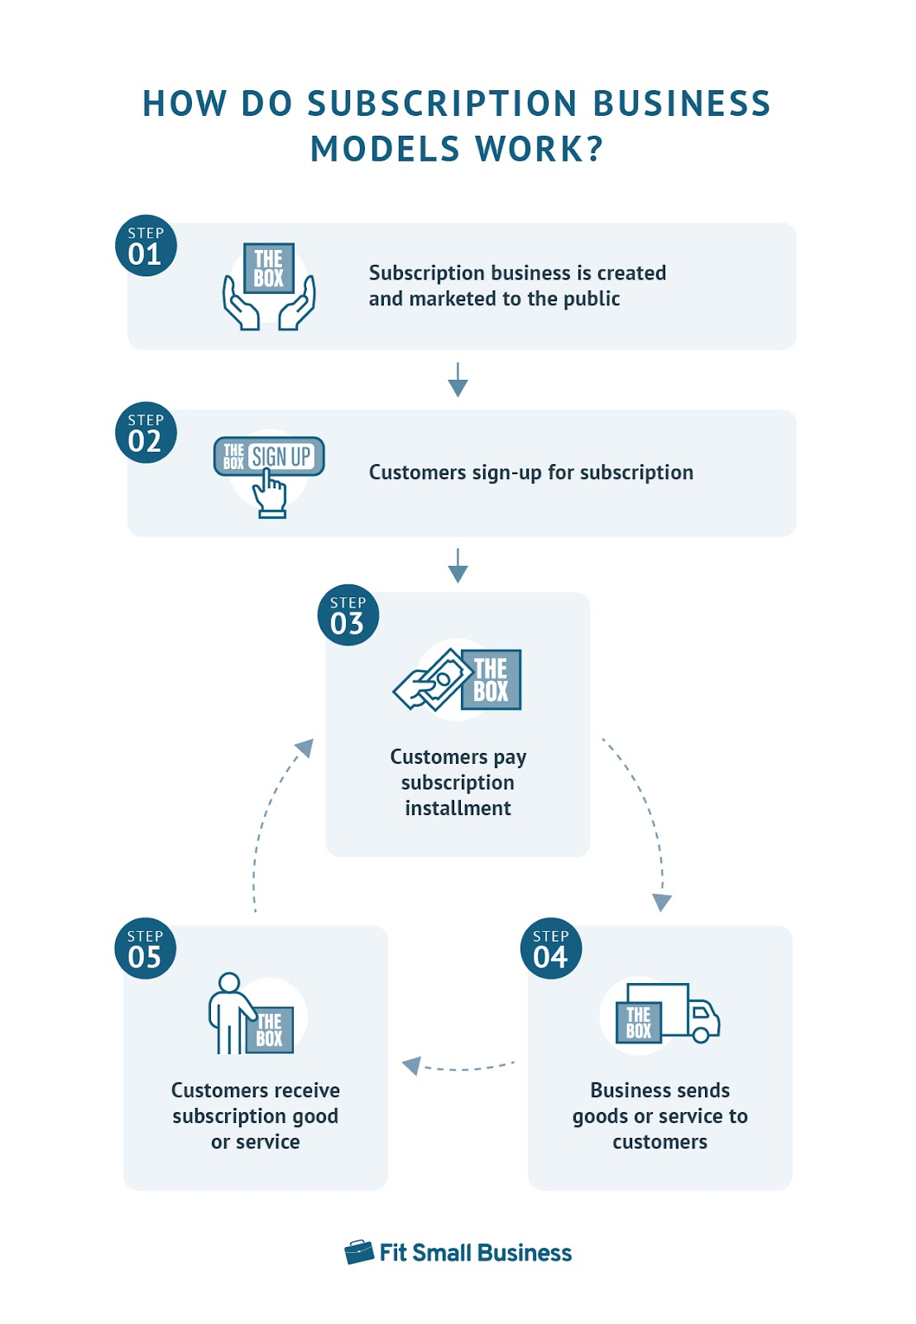
Key Features: -
01
Premium Waste Collection:
• Subscribers enjoy scheduled and optimized waste collection services tailored to their needs.
• Regular pickups ensure timely removal of waste, maintaining cleanliness and hygiene.
Subscription-Based Model
02
Recycling Rewards:
• Introduce a rewards program where subscribers earn points for proper recycling practices.
• Points can be redeemed for discounts, vouchers, or exclusive offers from local businesses.
Implementing a subscription-based model for waste management and recycling services involves offering residents and businesses a convenient and premium solution for their waste disposal needs. Subscribers would pay a regular fee to access a range of enhanced waste management services, including optimized garbage collection, recycling incentives, and additional perks.
03
Educational Resources:
• Provide subscribers with access to educational modules, promoting sustainable living and waste reduction.
• Regular tips and updates on eco-friendly practices enhance user engagement.
04
Exclusive Events and Initiatives:
• Organize exclusive events, workshops, or community initiatives for subscribers.
• Collaborate with local businesses to sponsor events and provide additional benefits
READ MORE
05
Partnerships and Collaborations
Form partnerships with local recycling centers, incentivizing residents to recycle by offering
discounts or rewards. Collaborate with local transportation services for efficient and eco-friendly waste transportation.
Notes:
Drag & Drop to add a picture

Slide 9




Value Proposition
Efficiency and Convenience
Environmental Impact
Cost Reduction for Municipal
Effortless waste management for residents via a user-friendly app. Enhanced efficiency in transportation and cleaner hiring services, promoting accessibility.
Residents promote sustainability through proper waste disposal. Blockchain traceability ensures accountability, reducing illegal dumping and fostering environmental responsibility.
Optimize resource allocation and routes, delivering a cost-effective waste management solution for municipalities with budget constraints, reducing operational costs efficiently.
Notes:
Drag & Drop to add a picture

Slide 10


Mobile Application
Develop a robust mobile application for both Android and iOS platforms, providing easy access to all services.
Integrate GPS and mapping functionalities for accurate location tracking and route optimization.
Technological Strategy
The Technological Strategy of the Waste Management and Recycling System Application involves leveraging cutting-edge technologies to enhance waste management processes, improve sustainability, and foster environmental stewardship. This strategy encompasses the integration of advanced tools, data analytics, and smart solutions to address the complex challenges associated with waste and recycling.
Web Application
READ MORE
Develop a robust responsive web application, providing easy access to all services. Integrate
GPS and mapping functionalities for accurate location tracking and route optimization.
Notes:
Drag & Drop to add a picture

Slide 11
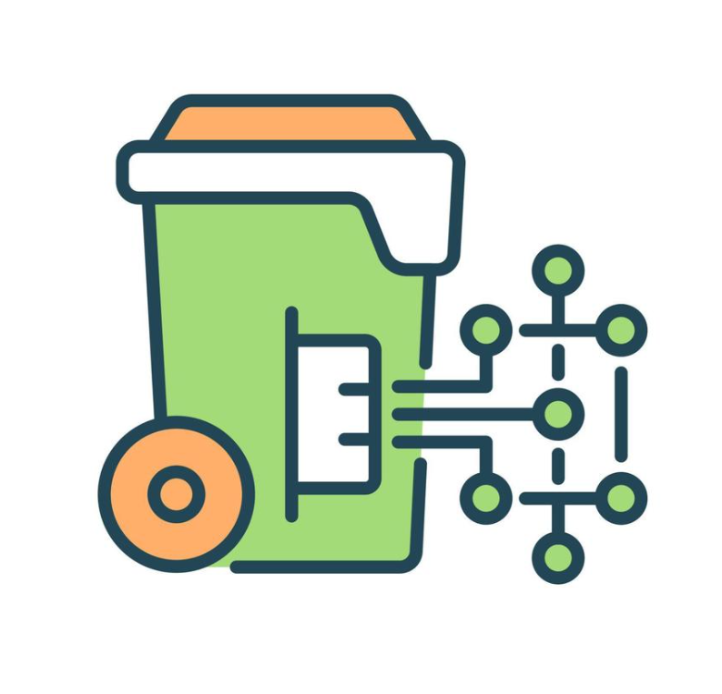



Additional Services
Smart Bin
Community Platform
Waste Disposal Guidance
Emergency Alerts
Integrate smart bin technology with sensors and RFID tags for real-time monitoring of waste levels. Optimize collection routes based on data analytics, reducing operational costs and environmental impact
Create a community forum or social platform within the application for residents to share eco-friendly tips, experiences, and collaborate on local initiatives
Provide guidelines and information on the proper disposal of hazardous waste, ensuring residents follow safe practices and comply with regulations.
Integrate an alert system to notify residents of environmental hazards, such as pollution or extreme weather events, ensuring their safety.
Notes:
Drag & Drop to add a picture

Slide 12
THANK YOU
Notes:
Drag & Drop to add a picture

